Slide 1
CSS
Cascading Style Sheet

Slide 2
What is CSS?
CSS stands for “Cascading Style Sheets”
Cascading refers to the procedure that determines which style will apply to a certain section, if you have more than one style rule.
Style how you want a certain part of your page to look. You can set things like color, margins, font, etc for things like tables, paragraphs, and headings.
Sheets the “sheets” are like templates, or a set of rules, for determining how the webpage will look.
CSS is a stylesheet language used to describe the presentation of a document written in HTML or XML.

Slide 3
Why Use CSS?
CSS is used to define styles for your web pages, including the design, layout and variations in display for different devices and screen sizes.

Slide 4
Advantages
A web application will contains hundreds of web pages, which are created using HTML.
Formatting these HTML pages will be a laborious process, as formatting elements need to be applied to each and every page.
CSS saves lots of work as we can change the appearance and layout of all the web pages by editing just one single CSS file.

Slide 5
CSS Syntax

Slide 6
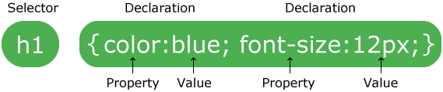
A CSS rule-set consists of a selector and a declaration block:
The selector points to the HTML element you want to style.
The declaration block contains one or more declarations separated by semicolons.
Each declaration includes a CSS property name and a value, separated by a colon.
Multiple CSS declarations are separated with semicolons, and declaration blocks are surrounded by curly braces.

Slide 7
Example
In this example all <p> elements will be center-aligned, with a red text color:
p { color : red ; text-align : center; }
Example Explained
p is a selector in CSS .
color is a property, and red is the property value
text-align is a property, and center is the property value

Slide 8
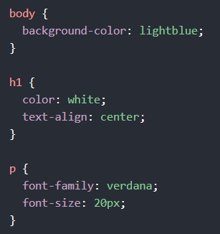
CSS Example

Slide 9
CSS Syntax Rules
Rule have two parts - Selector and declaration.
Selector
The HTML element you want to add style to.
<p> <h1> <table> etc
Declaration
The statement of style for that element. Made up of property and value.
Rules
Selector
Declaration
p { font-family : Arial ; }
Property
Value
Declaration

Slide 10
Example
Selector - I want the text color of my paragraph to be red and the background color to be black.
<html>
<head>
<style> p {font-family:Arial;
color: red;
background-color:black;}
</style>
</head>
<body>
<p> <b> Welcome to Coder Decoder</b> </p>
</body>
</html>
Welcome to Coder Decoder

Slide 11
CSS Selectors
Declaring a CSS Rule for a Elements Attribute
It will style all the content of that element which you are selecting.
Example
The HTML
<p>
Welcome to the Coder Decoder
</p>
<p>
<b><i> Powered by – Dhirendra Chauhan</i></b>
</p>
The CSS
p {text-align: center; color: blue;}

Slide 12
CSS Selectors
Grouping Selectors
You can group all the selectors of same style to minimize the code. The selectors should be separated with comma.
Example
h2 {text-align: center; color: red; } p {text-align: center; color: red;}
Grouped Selectors
h2, p { text-align: center; color: red; }

Slide 13
Inserting a StyleSheet
Three different ways
External Style Sheet
Internal Style Sheet
Inline Styles

Slide 14
Inline CSS
Inline CSS contains the CSS property in the body section attached with element is known as inline CSS. This kind of style is specified within an HTML tag using the style attribute.
<html>
<head>
<title>Inline CSS</title>
</head>
<body>
<p style = "color:#009900; font-size:50px; font-style:italic; text-align:center;">
Coder Decoder
</p>
</body>
</html>
Coder Decoder

Slide 15
Internal or Embedded CSS
An internal stylesheet holds CSS rules for the page in the head section of the HTML file. The rules only apply to that page, but we can configure CSS classes and IDs that can be used to style multiple elements in the page code.

Slide 16
<head>
<style type =“text / css”>
h3 { font-style:bold; font-size:20px; }
</style>
</head>

Slide 17
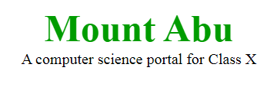
<html>
<head>
<title>Internal CSS</title>
<style>
.main { text-align:center; }
.coder { font-style:bold; font-size:20px; }
</style>
</head>
<body>
<div class = "main">
<div class ="GFG">Mount Abu</div>
<div class =“coder">
A computer science portal for Class X
</div>
</div>
</body>
</html>

Slide 18
External CSS
External CSS contains separate CSS file which contains only style property with the help of tag attributes ( For example class, id, heading, … etc ).
An external ( also called linked ) style sheet carries essentially the same information as an internal style sheet in the sense that external style sheet is contained inn its own text file ( having extension .css )

Slide 19
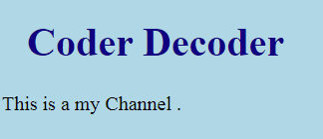
Example
<html> <head> <link rel="stylesheet" href="mystyle.css"> </head> <body> <h1>Coder Decoder</h1> <p>This is a my Channel.</p> </body> </html>
"mystyle.css"
body { background-color: lightblue; } h1 { color: navy; margin-left: 20px; }

Slide 20
CSS Properties
CSS Background
We can use CSS Background properties to define the background effects of an element. The following properties can be used for background effects :
background-color
background-image
background-repeat
background-position

Slide 21
CSS Properties
CSS Background Image
You can use an image as the background for an element using background-image property.
Example:-
body{
background-image : url(‘java.png’);
}

Slide 22
CSS Properties
CSS Background Color
The background-color property is used to specify the background color of an element.
Example:
body {
background-color : darkblue;
}
p {
background-color : orange;
}

Slide 23
CSS Properties
CSS Background Position
If the background image disturbs the text, i.e. if the text cannot be read clearly due to the image in the background, we can set the position of the background image.
Example:
body {
background-image :url(“CoderDecoder.jpg"); background-repeat : no-repeat;
background-position :right top;
}

Slide 24
CSS Properties
Text Alignment
We can either align the text to the left, right, center or we can make it justified.
Example-
p { text-align : left;}
h1{text-align : center;}
Text Color
The color property is used to set the color of text.
Example-
body{ color : blue;}
p1 { color : magenta;}

Slide 25
CSS Properties
Text Formatting
The following properties can be used for formatting text :
Text Color
Text Alignment
Text Decoration
Text Transformation
Text Indentation

Slide 26
CSS Properties
Text Decoration
You can use text-decoration property to set or remove decorations from text.
Example-
p {text-decoration:overline;}
p {text-decoration:line-through;} p {text-decoration:underline;}
Text Transformation
You can use text-transform property to specify uppercase and lowercase letters of any text.
Example-
h1 {text-transform:uppercase;} h2 {text-transform:lowercase;} p {text-transform:capitalize;}

Slide 27
CSS Properties
CSS Font Size
You can use the font-size property to set the size of text. The font-size value can be absolute or it can be relative.
Exampleh1 {
font-size: 30px;
}
p {
font-size: 14px;
}

Slide 28
CSS Properties
CSS Links
You can use CSS styles to style any link. Links can be styled in different ways by using any CSS property like color, font-family etc.
Links can be in one of the following states :
a : link – Unvisited link
a : visited – A link that the user has visited
a : hover – A link over which the mouse pointer is moving
a : active – A link, which has been just clicked

Slide 29
CSS Properties
CSS Links
a { font-weight: bold; }
a : link { color: black; }
a : visited { color : gray; }
a:hover {
text-decoration: none;
color: white;
background-color: navy;
}
a : active {
color: aqua;
background-color : navy;
}
Styling Links
link - before a visit
visited - after it has been visited
hover - when your mouse is over it but you have not clicked
active - you have clicked it and you have not yet seen the new page

Slide 30
CSS Properties
CSS List
We can use CSS list properties for
Setting different list item markers for ordered lists
Setting different list item markers for unordered lists
Set an image as the list item marker
Values
list-style-type
list-style-image

Slide 31
CSS Properties
CSS Border
You can use the CSS Border properties to specify the style and color of an element’s border.
Values
border-style
border-width
border-color

Slide 32
CSS Properties
CSS Margin
Using CSS Margin properties you can specify the space around elements.
Values:
margin-top:50px;
margin-bottom:30px;
margin-right:25px;
margin-left:10px;

Slide 33

Thank You

